Slide 1


At a Glance
Project Name : DWBWS Project
Project Cost : BDT 16.93 Crore

Slide 2
Objective
To Ensure the benchmark of bottled water Quality.
To Control the Price in bottled water market
To support Government at any natural
Disaster (Like Sidr, Flood , earthquake-Nepal, etc)
Ensure availability of mineral water

Slide 3
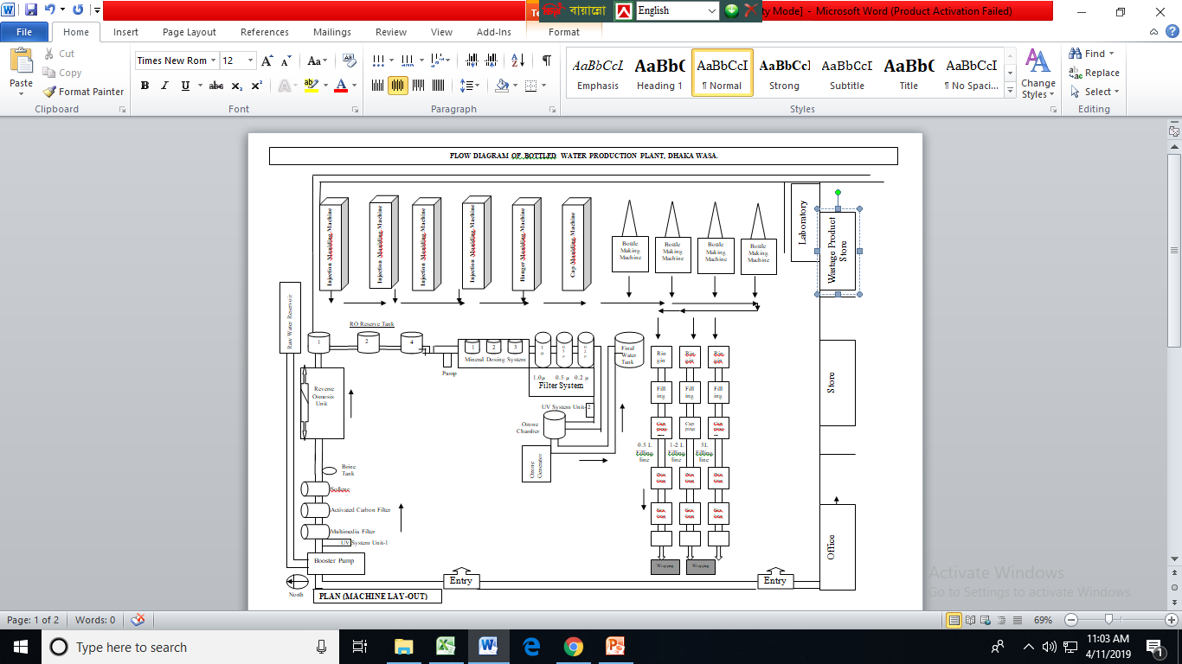
Lay out of Bottled Water Plant

Slide 4
Nine Year’s Production
Sl. No | Financial Year | Production (Lakh Litre)
1 | 2013-14 | 30.72
2 | 2014-15 | 64.22
3 | 2015-16 | 79.93
4 | 2016-17 | 98.19
5 | 2017-18 | 101.108
6 | 2018-19 | 103.989
7 | 2019-20 | 81.111
8 | 2020-21 | 62.575 (COVID-19, effect)
9 | 2021-22 | 20.41 (27th Oct’-21) (COVID-19, effect)

Slide 5
Nine Year’s Sales
Sl. No | Financial Year | Sale (In lakh)
1 | 2013-14 | 243.24
2 | 2014-15 | 285.55
3 | 2015-16 | 326.83
4 | 2016-17 | 369.77
5 | 2017-18 | 401.58
6 | 2018-19 | 363.257
7 | 2019-20 | 285.090
8 | 2020-2021 | 217.851(COVID-19, effect)
9 | 2021-2022 | 73.88(27th Oct’-21) (COVID-19, effect)

Slide 6
Nine Year’s Expenditure
Sl. No | FY Year | Expenditure (In lakh) Fixed Asset | Expenditure (In lakh) Raw Material | Various salary, electric fuel TNT bill, Imprest, Conveyance, OT & etc | Total (Taka in Lakh)
1 | 2013-14 | 245.00 | 360.00 |  | 605.00
2 | 2014-15 | 154.00 | 263.00 |  | 417.00
3 | 2015-16 | 147.00 | 290.00 |  | 437.00
4 | 2016-17 | 214.00 | 220.00 |  | 434.00
5 | 2017-18 | 256.56 | 235.83 |  | 492.39
6 | 2018-19 | 198.64 | 212.00 |  | 410.64
7 | 2019-20 | 75.659 | 228.808 |  | 304.467
8 | 2020-21 | 131.995 | 111.864 | 121.43 | 365.289
9 | 2021-22 | 12.434 | 19.317 | 32.418 | 64.169 (27th Oct-21)

Slide 7
Nine Year’s VAT, SD,
Sl. No | Financial Year | VAT+ SD+ Source Tax (In Lakh)
1 | 2013-14 | 39.36
2 | 2014-15 | 43.07
3 | 2015-16 | 37.94
4 | 2016-17 | 43.60
5 | 2017-18 | 53.40
6 | 2018-19 | 40.80
7 | 2019-20 | 29.90
8 | 2020-21 | 35.49
9 | 2021-22 | 9.09(Sep-21)
** 15% VAT & 5% SD Applicable for 250ml -2000ml bottle water ** Only 15% VAT Applicable for 5000ml -20000ml bottle or water

Slide 8
Profit – Loss FY: 2020-2021
Sl. No | Description |  | Taka (Lakh)
EXPENSE
1 | Raw material |  |  |  | 111.846
2 | Operational Cost (out source & Master role Salary) |  |  |  | 65.191
3 | VAT & SD |  |  |  | 35.49
4 | Electricity, Telephone, Fuel, Water etc |  |  |  | 41.849
5 | Imprest, Conveyance , Honorarium, OT etc |  |  |  | 14.393
6 | In FY 2020-21, 5% depreciation of the Fixed Asset (131.995) |  |  |  | 6.599
Total Expense 275.013
INCOME
1 |  | Sales |  | 217.851
Total Income 217.851
Loss =57.162

Slide 9
Profit – Loss FY: 2021-2022(27th Oct-21)
Sl. No | Description |  |  | Taka (Lakh)
EXPENSE
1 | Raw material |  |  |  |  | 19.317
2 | Operational Cost (out source & Master role Salary) |  |  |  |  | 16.470
3 | VAT & SD |  |  |  |  | 9.09
4 | Electricity, Telephone, Fuel, Water etc |  |  |  |  | 10.301
5 | Imprest, Conveyance , Honorarium, OT etc |  |  |  |  | 5.639
6 | In FY 2020-21, 5% of the Fixed Asset (12.434) |  |  |  |  | 0.621
Total Expense |  |  |  |  |  | 61.438
INCOME
1 |  | Sales
 |  | Total Income |  |  | 73.88 (27th Oct-21)
Profit |  |  |  |  | =12.442

Slide 10
Official Documentation
BSTI License (Valid up to 30/6/24, On Process)
Trade Mark “Shanti” (J#280, up to 2023)
KPI (Class 1 Ga),Premises L#CSD/TEJ-594
Insurance (Tk. 840.59 Lac, up to 21/10/22)
Trade License (Valid up to 2021-22)
(No:-050266)
BIN:003418771-0401
Tax Certificate(TIN:-141-7000027)

Slide 11
Marketing Strategies
Thana base dealership under DMP
Corporate dealership i.e. Bank, Institute
WASA Office sales centre i. e. WASA Bhaban, MODS zone- 1, 3, 4, 6, 9, Central Lab, Pagla Vander .
Tender Notice, Web Site
Mobile cover van.
Advertisement through Leaflet, Banner, Festoon etc.

Slide 12
Challenges of Marketing
Only One product.
No advertisement in Electronic & Print Media.
Directions from PM office to consume ‘Mukta’ at any official program.
No professional marketing wing or resources.
Competitive water market.
Not available at every shop. (Dues, Push sale..).
No awareness campaign (mineral).
No commission or extra facilities for Dealer
***Less attention (in marketing policy)

Slide 13
Remarkable Activities
100% Online Sale (POS), Payment.
100% Online Store Inventory
BWPP Plant under CCTV Coverage.
100% Procurement by e-GP
100% e-nothi introduced.
Biometric Attendance of all staffs and workers
Supply of 5Litre bottle water to Rohinga camp, Kotupalong.
National day, Victory day campaign etc.
Attending National Mela to Campaign.
LIMS SOFTWARE is on and production SOFTWARE is in progress.

Slide 14
Recommendations
Introduce Sales center at all MODS Zone (MODS Zone -2, 5 & 8 immediately) & Local level office.
WASA link 16162, Welcome tune & Water bill collection paper.
Advertisement in Print & Electronic Media.
Involve Revenue Official, Staff.
Water & Sewer bill message/Slogan.
Mobile Ring tone of Corporate SIM.
Human Resource (HR) Management.
Introduce ‘ Shanti’ bottled water at convenient water ATM booth.
City corporation display.

Slide 15
Issues for Discussion & Guidance
BSTI
PET & PC jar
ATM water services.
Water Quality
Some times water quality Deteriorates
High iron concentration in tube well (source) water. (About 0.7 ppm)

